Slide 1
Starting where we left off: Coercion
When you call a function with an argument of the wrong type, R will try to coerce values to a different type so that the function will work.
Fixing the name variable
class(Auto$name)
## [1] "factor"
Auto[,9]<-as.character(Auto[,9]) Auto[, 'name'] <- as.character(Auto[, 'name']) ##Same as above
str(Auto)

Slide 2
dplyr library
library(dplyr)
dplyr is a data manipulation package, providing a consistent set of verbs that help you solve the most common data manipulation challenges:
mutate() adds new variables that are functions of existing variables.
select() picks variables based on their names.
filter() picks cases based on their values.

Slide 3
Comparing summarize from dplyr with summary
summary(Auto)
## mpg cylinders displacement horsepower weight ## Min. : 9.00 Min. :3.000 Min. : 68.0 Min. : 46.0 Min. :1613 ## 1st Qu.:17.50 1st Qu.:4.000 1st Qu.:104.0 1st Qu.: 75.0 1st Qu.:2223 ## Median :23.00 Median :4.000 Median :146.0 Median : 93.5 Median :2800 ## Mean :23.52 Mean :5.458 Mean :193.5 Mean :104.5 Mean :2970 ## 3rd Qu.:29.00 3rd Qu.:8.000 3rd Qu.:262.0 3rd Qu.:126.0 3rd Qu.:3609 ## Max. :46.60 Max. :8.000 Max. :455.0 Max. :230.0 Max. :5140 ## NA's :5 ## acceleration year origin name ## Min. : 8.00 Min. :70.00 Min. :1.000 Length:397 ## 1st Qu.:13.80 1st Qu.:73.00 1st Qu.:1.000 Class :character ## Median :15.50 Median :76.00 Median :1.000 Mode :character ## Mean :15.56 Mean :75.99 Mean :1.574 ## 3rd Qu.:17.10 3rd Qu.:79.00 3rd Qu.:2.000 ## Max. :24.80 Max. :82.00 Max. :3.000 ##
summarize(Auto,avg=mean(mpg))
## avg ## 1 23.51587

Slide 4
Editing The horsepower Variable
We can use the filter command to filter out the ? Question mark values.
class(Auto$horsepower)
## [1] "numeric"
Questions<-filter(Auto,horsepower=="?")
Auto[,4]<-as.numeric(unlist(Auto[,4]))
summary(Auto $horsepower)
## Min. 1st Qu. Median Mean 3rd Qu. Max. NA's ## 46.0 75.0 93.5 104.5 126.0 230.0 5
Why you might need unlist:
Given a list structure x, the unlist() function simplifies it to produce a vector which contains all the atomic components which occur in x

Slide 5
Separating Columns in R
Separate first three columns
firstgroup<-select(Auto,mpg,cylinders,displacement) head(newData)
## mpg cylinders displacement ## 1 18 8 307 ## 2 15 8 350 ## 3 18 8 318 ## 4 16 8 304 ## 5 17 8 302 ## 6 15 8 429
Separate last three columns
secondgroup<-select(Auto,horsepower,weight,acceleration) #part of dplyr package head(secondhalf)
## horsepower weight acceleration ## 1 130 3504 12.0 ## 2 165 3693 11.5 ## 3 150 3436 11.0 ## 4 150 3433 12.0 ## 5 140 3449 10.5 ## 6 198 4341 10.0
Bind Columns Back Together
mergedata<-cbind(firstgroup,secondgroup) head(mergedata)
## mpg cylinders displacement horsepower weight acceleration ## 1 18 8 307 130 3504 12.0 ## 2 15 8 350 165 3693 11.5 ## 3 18 8 318 150 3436 11.0 ## 4 16 8 304 150 3433 12.0 ## 5 17 8 302 140 3449 10.5 ## 6 15 8 429 198 4341 10.0

Slide 6
Assessing Model Accuracy
“No free lunch in statistics: no one method dominates all others over all possible datasets”

Slide 7
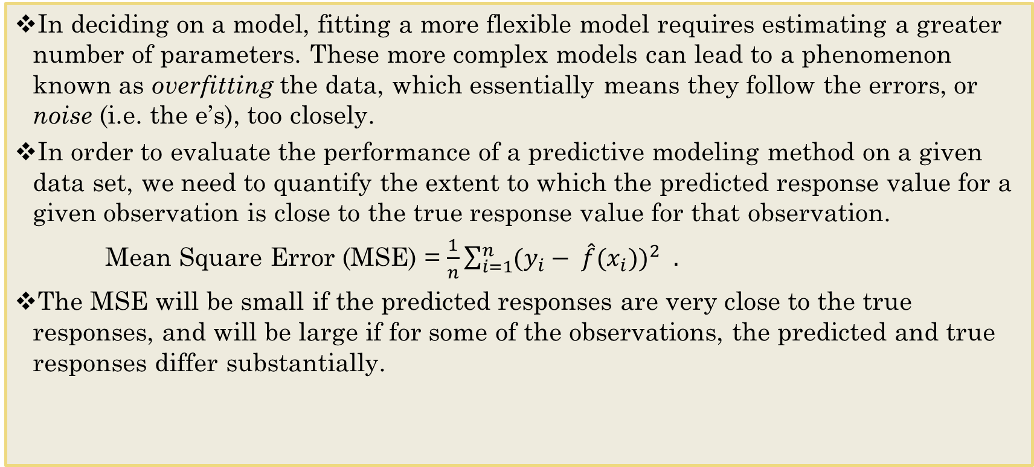
Overfitting and MSE
In deciding on a model, fitting a more flexible model requires estimating a greater number of parameters. These more complex models can lead to a phenomenon known as overfitting the data, which essentially means they follow the errors, or noise (i.e. the e’s), too closely.
In order to evaluate the performance of a predictive modeling method on a given data set, we need to quantify the extent to which the predicted response value for a given observation is close to the true response value for that observation.
Mean Square Error (MSE) = $\frac{1}{n}{\sum_{i=1}^{n}{(y_{i}}− \hat{f}{(x}_{i}))}^{2 }$
The MSE will be small if the predicted responses are very close to the true responses, and will be large if for some of the observations, the predicted and true responses differ substantially.

Slide 8
Example of MSE calculation
#install.packages(“mltools”)
library(mltools) actuals <- c(1.0, 2.0, 9.5)
pred <- c(0.9, 2.1, 10.0)
mse(pred, actuals)
## [1] 0.09
summsquares<-(1-.9)^2+(2-2.1)^2+(9.5-10)^2 mse<-summsquares/3 mse<-summsquares/length(pred) mse
## [1] 0.09

Slide 9
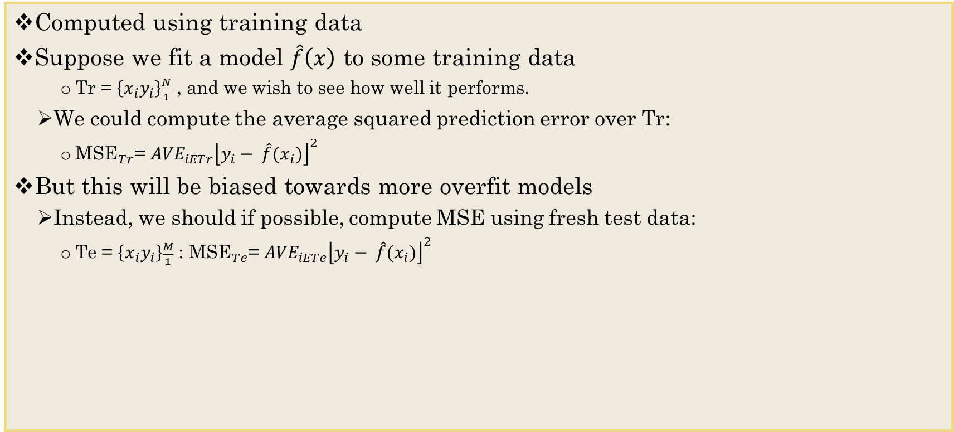
Mean Square Error (MSE)
Computed using training data
Suppose we fit a model $\hat{f}\left(x\right)$ to some training data
Tr = $\left\{x_{i}y_{i}\right\}\frac{N}{1}$ , and we wish to see how well it performs.
We could compute the average squared prediction error over Tr:
${\text{MSE}}_{Tr}$= ${{AVE}_{iETr}\left\lfloor y_{i}− \hat{f}{(x}_{i})\right\rfloor }^{2}$
But this will be biased towards more overfit models
Instead, we should if possible, compute MSE using fresh test data:
Te = $\left\{x_{i}y_{i}\right\}\frac{M}{1}$ : ${\text{MSE}}_{Te}$= ${{AVE}_{iETe}\left\lfloor y_{i}− \hat{f}{(x}_{i})\right\rfloor }^{2}$

Slide 10
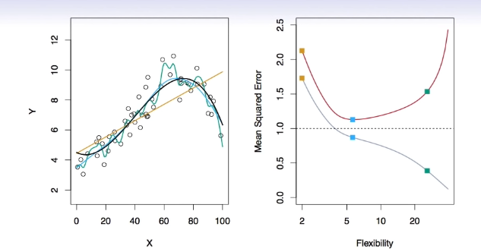
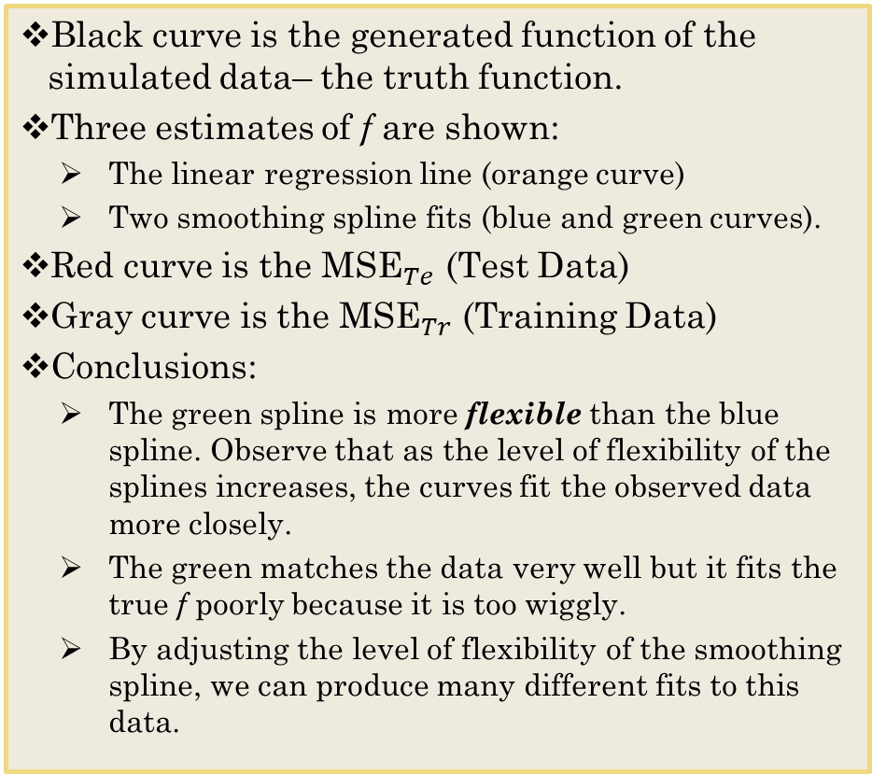
Bias-Variance Tradeoff: Smoothing Spline
Black curve is the generated function of the simulated data– the truth function.
Three estimates of f are shown:
The linear regression line (orange curve)
Two smoothing spline fits (blue and green curves).
Red curve is the ${\text{MSE}}_{Te}$ (Test Data)
Gray curve is the ${\text{MSE}}_{Tr}$ (Training Data)
Conclusions:
The green spline is more flexible than the blue spline. Observe that as the level of flexibility of the splines increases, the curves fit the observed data more closely.
The green matches the data very well but it fits the true f poorly because it is too wiggly.
By adjusting the level of flexibility of the smoothing spline, we can produce many different fits to this data.

Slide 11
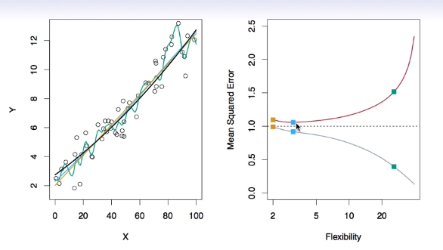
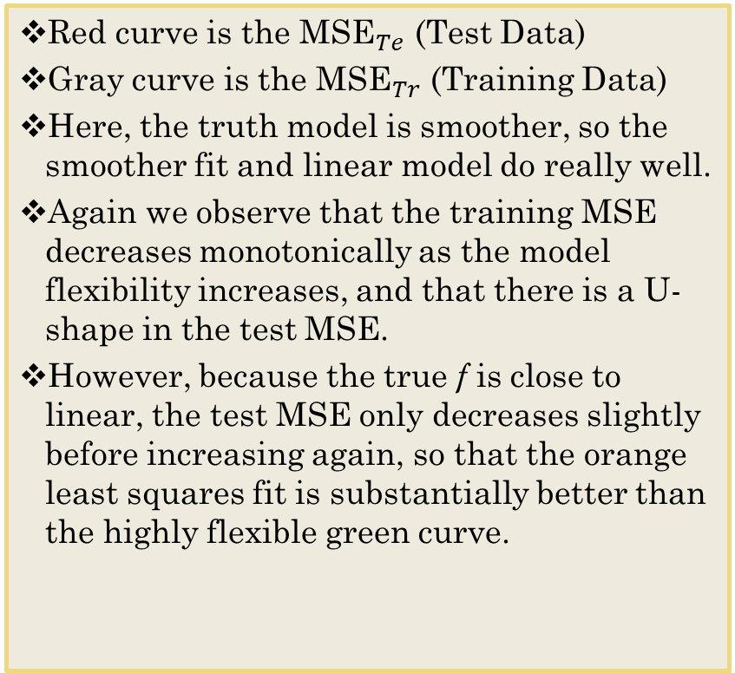
Bias-Variance Tradeoff: Linear Model
Red curve is the ${\text{MSE}}_{Te}$ (Test Data)
Gray curve is the ${\text{MSE}}_{Tr}$ (Training Data)
Here, the truth model is smoother, so the smoother fit and linear model do really well.
Again we observe that the training MSE decreases monotonically as the model flexibility increases, and that there is a U-shape in the test MSE.
However, because the true f is close to linear, the test MSE only decreases slightly before increasing again, so that the orange least squares fit is substantially better than the highly flexible green curve.

Slide 12
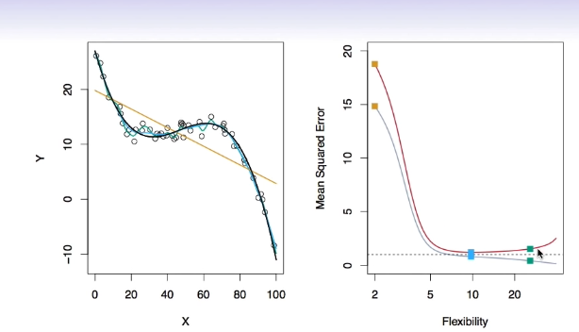
Bias-Variance Tradeoff: Non-Linear
Finally, here is an example of an f that is highly non-linear.
Here, the truth model is wiggly, and the noise is low, so the more flexible test fits the best.
The training and test MSE curves still exhibit the same general patterns, but now there is a rapid decrease in both curves before the test MSE starts to increase slowly.

Slide 13
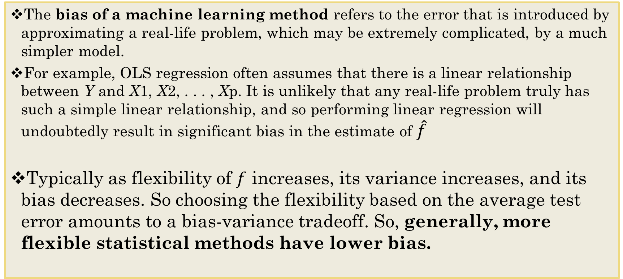
Bias-Variance Trade-off
The bias of a machine learning method refers to the error that is introduced by approximating a real-life problem, which may be extremely complicated, by a much simpler model.
For example, OLS regression often assumes that there is a linear relationship between Y and X1, X2, . . . , Xp. It is unlikely that any real-life problem truly has such a simple linear relationship, and so performing linear regression will undoubtedly result in significant bias in the estimate of $\hat{f}$
Typically as flexibility of $f$ increases, its variance increases, and its bias decreases. So choosing the flexibility based on the average test error amounts to a bias-variance tradeoff. So, generally, more flexible statistical methods have lower bias.

Slide 14
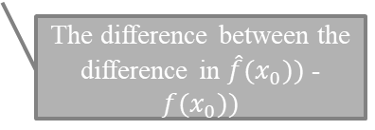
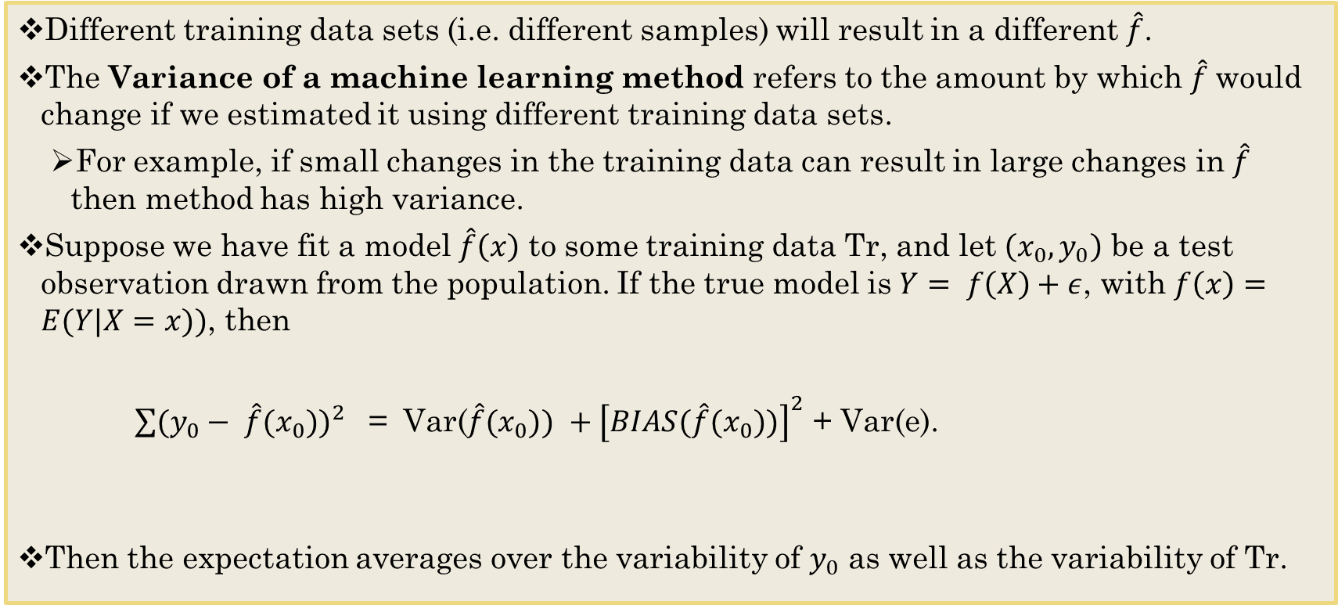
Bias-Variance Trade-off
Different training data sets (i.e. different samples) will result in a different $\hat{f}$.
The Variance of a machine learning method refers to the amount by which $\hat{f}$would change if we estimated it using different training data sets.
For example, if small changes in the training data can result in large changes in $\hat{f}$ then method has high variance.
Suppose we have fit a model $\hat{f}\left(x\right)$ to some training data Tr, and let $\left(x_{0},y_{0}\right)$ be a test observation drawn from the population. If the true model is $Y= f\left(X\right)+ε$, with $f\left(x\right)=E(Y|X=x))$, then
${\sum{(y_{0}}− \hat{f}{(x}_{0}))}^{2 }$ = ${ \text{Var}\text{(}\hat{f}{(x}_{0})) +\left[BIAS(\hat{f}{(x}_{0}))\right]}^{2}$ + Var(e).
Then the expectation averages over the variability of $y_{0}$ as well as the variability of Tr.
The Variance for having different training sets
Irreducible error
The difference between the difference in $\hat{f}{(x}_{0}))$ - $f{(x}_{0}))$

Slide 15
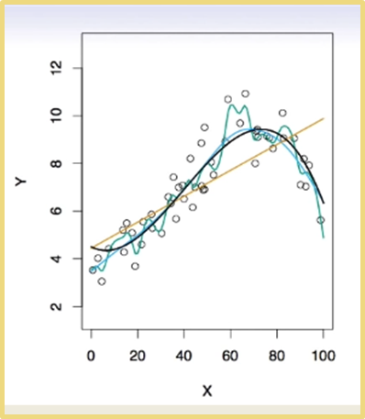
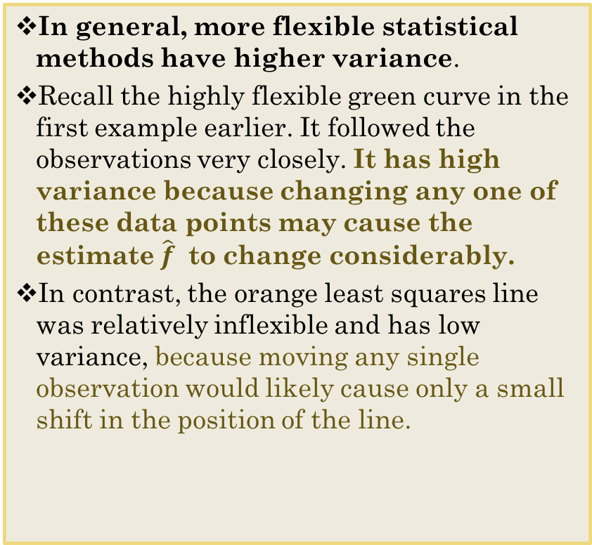
Bias-Variance Trade-off
In general, more flexible statistical methods have higher variance.
Recall the highly flexible green curve in the first example earlier. It followed the observations very closely. It has high variance because changing any one of these data points may cause the estimate $\hat{f}$ to change considerably.
In contrast, the orange least squares line was relatively inflexible and has low variance, because moving any single observation would likely cause only a small shift in the position of the line.

Slide 16
Bias-Variance Trade-off
When Flexibility is high, Variance is high, Bias is low
But when Flexibility is low, Variance is low, but Bias is high
In order to minimize the test MSE, we need to select a machine learning method that simultaneously achieves low variance and low bias.
Since we can seldom do both, our search for an effective machine learning algorithm involves evaluating models of varying flexibility to seek an acceptable trade-off between bias and variance.

Slide 17
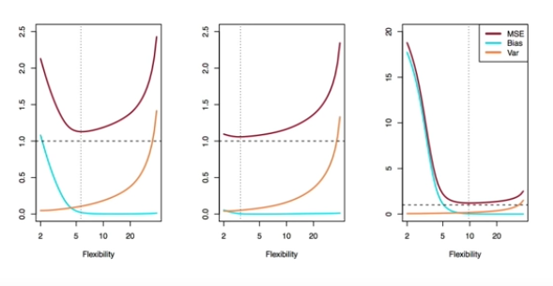
Bias-Variance trade-off for the three examples.
The three plots above illustrate the bias-variance tradeoff as flexibility increases for the three earlier examples.
The blue curves are squared bias, the orange curves are variance, and the dashed lines are Var(e)
The test MSE (red curve) is the sum of these three curves.
The vertical dotted line indicates the flexibility level corresponding to the smallest test MSE.

Slide 18
To Do
Case Study 1 due by time in Blackboard
Be sure to fill out the teammates request to peer evaluate your team.
Work through Loading_Data Swirl lesson to get a sense of what you can do.
Note that this swirl is a little limited in just focusing on datasets in R and that you need to review what we did in class as well.
Use install.packages(“ISLR”) before starting
Investigate the dplyr and ggplot2 packages on your own to see its full capabilities.
Read Chapter 2 in textbook if you have not done so already.

